Slide 1


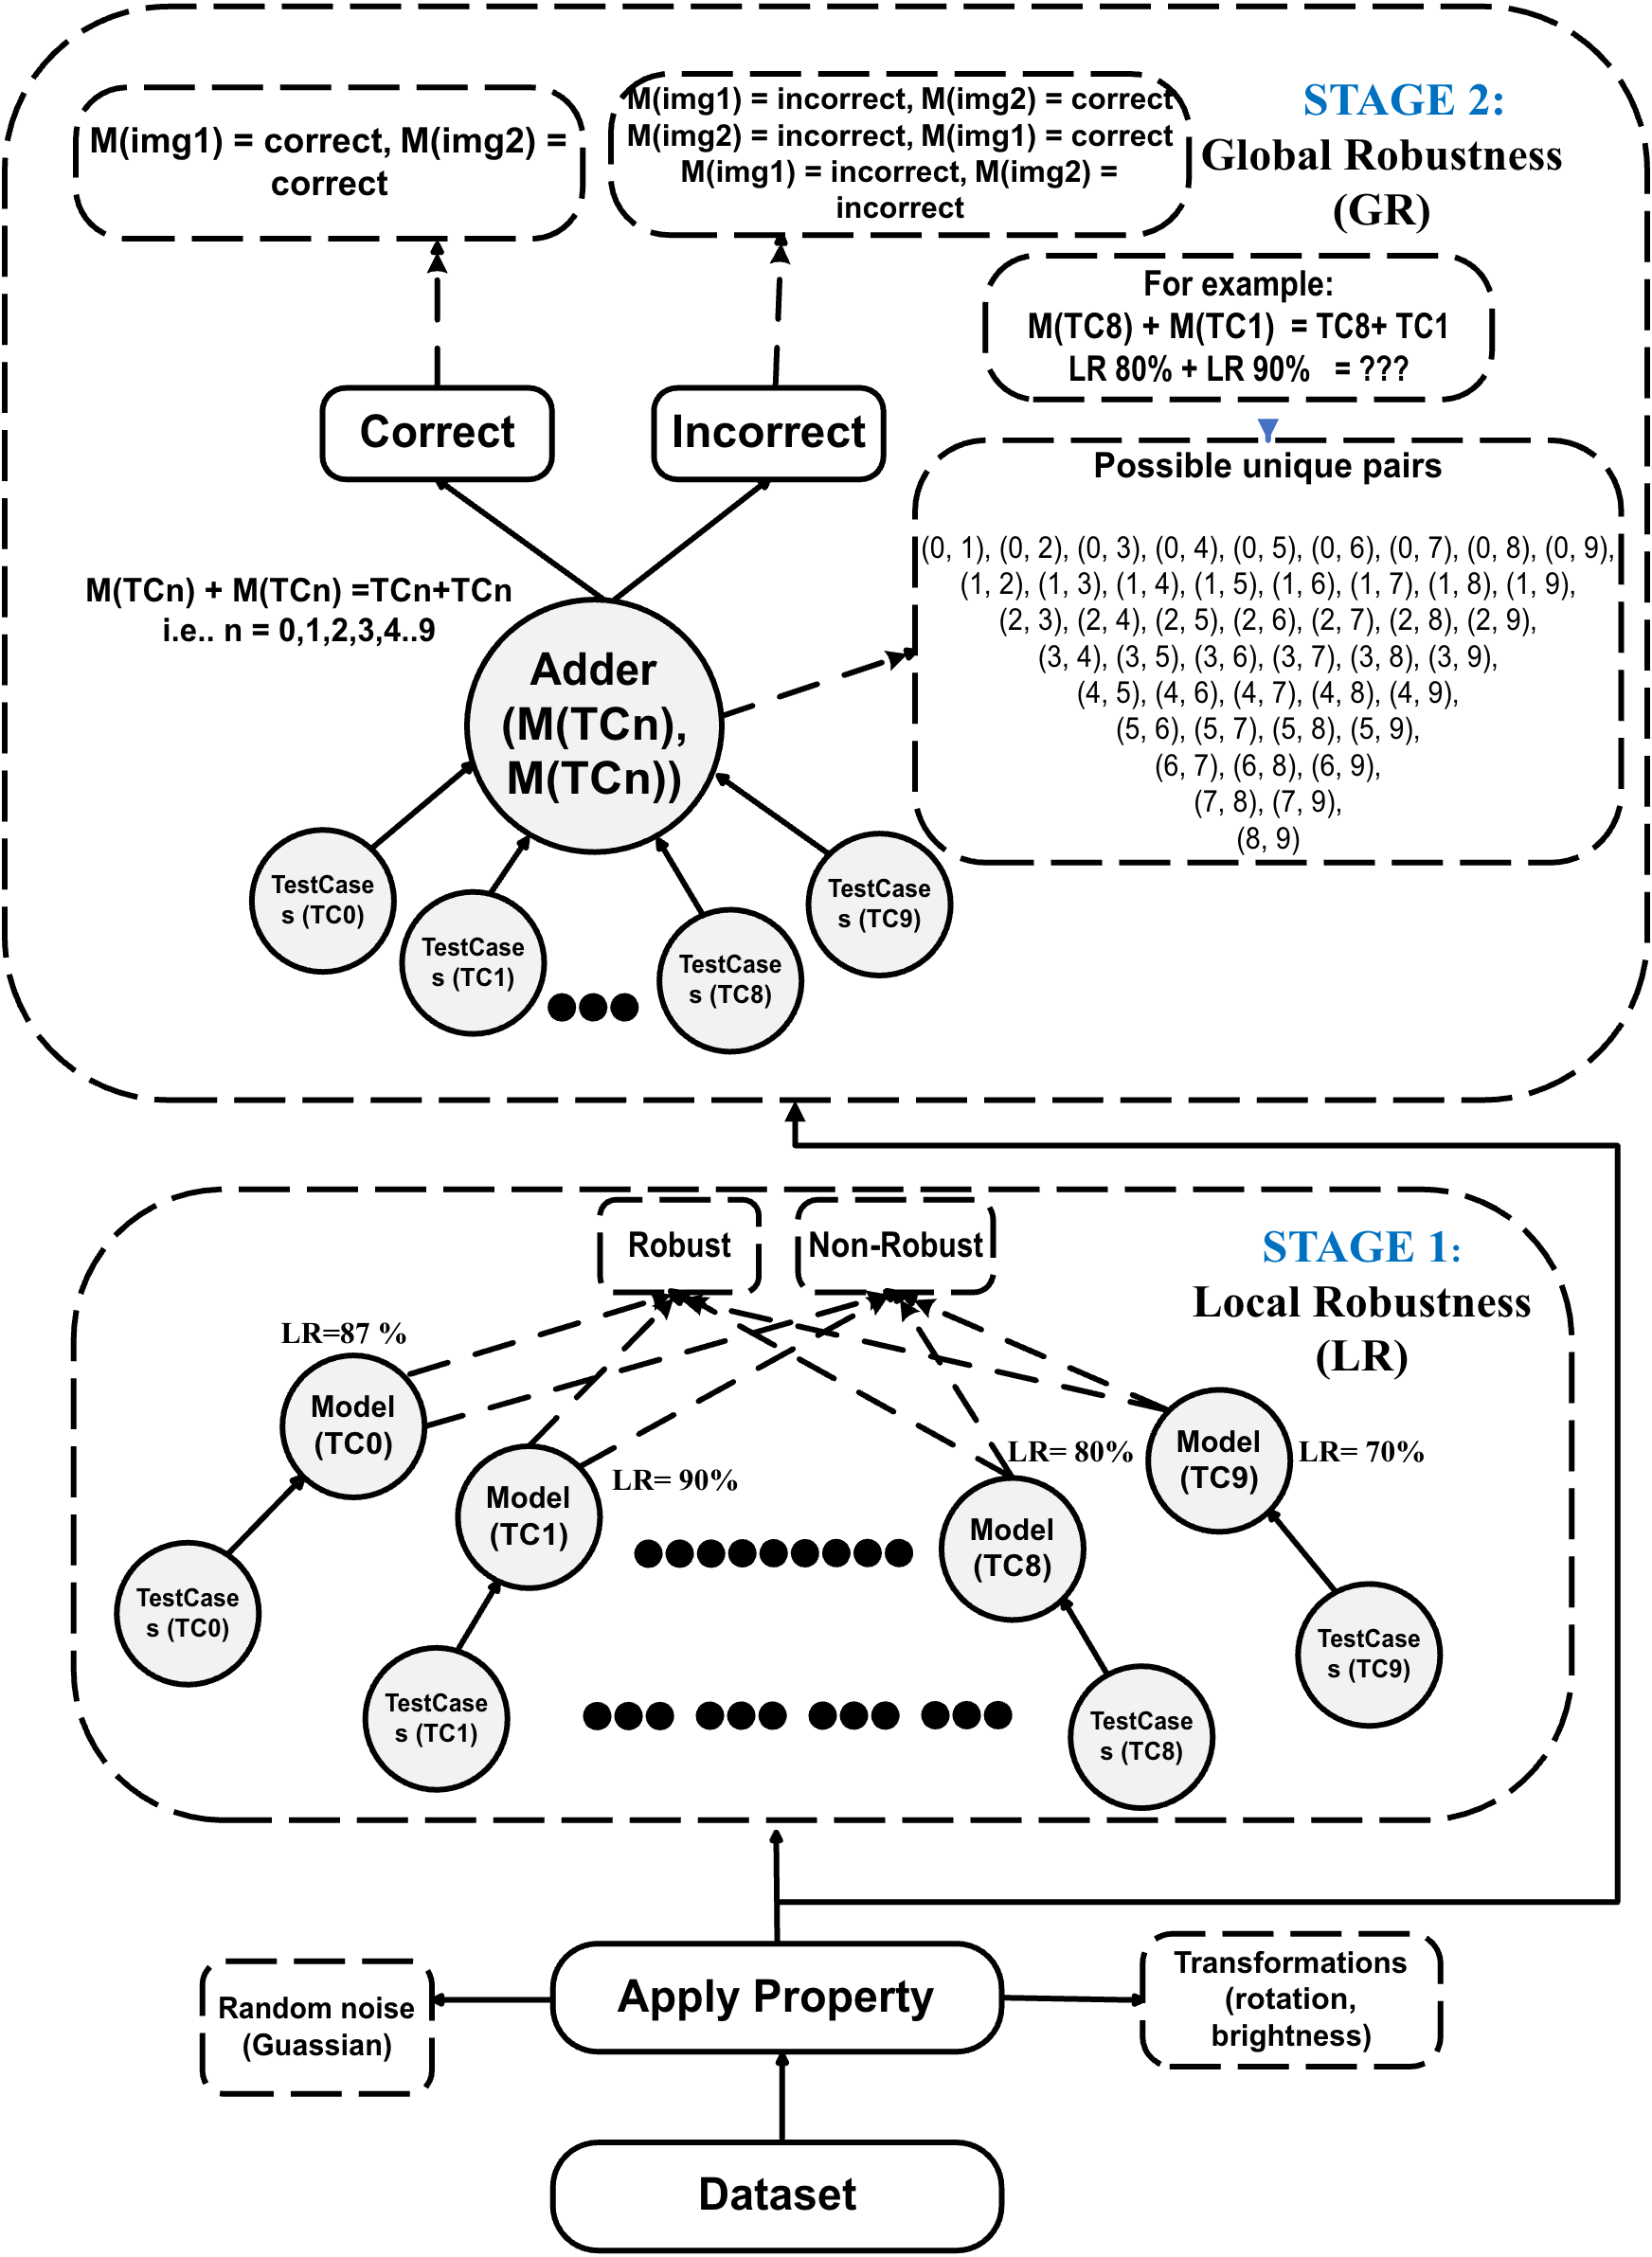
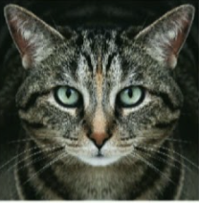
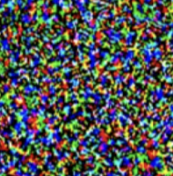
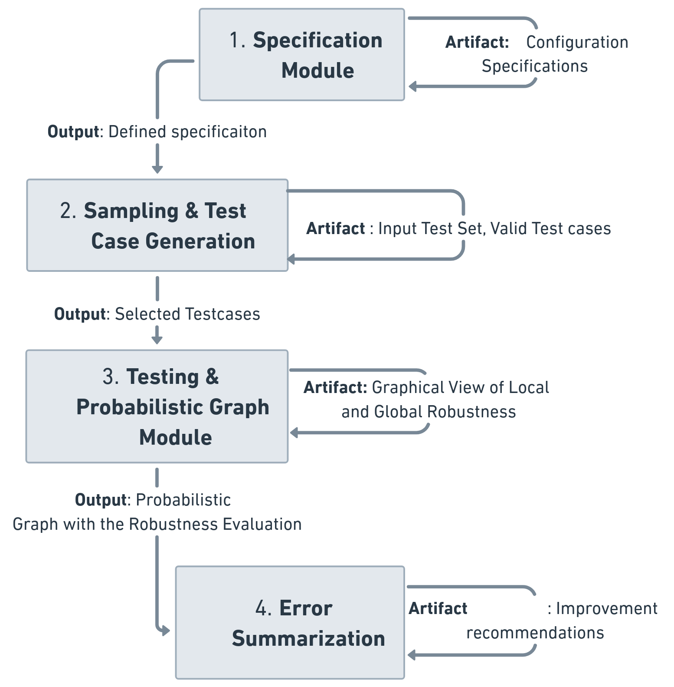
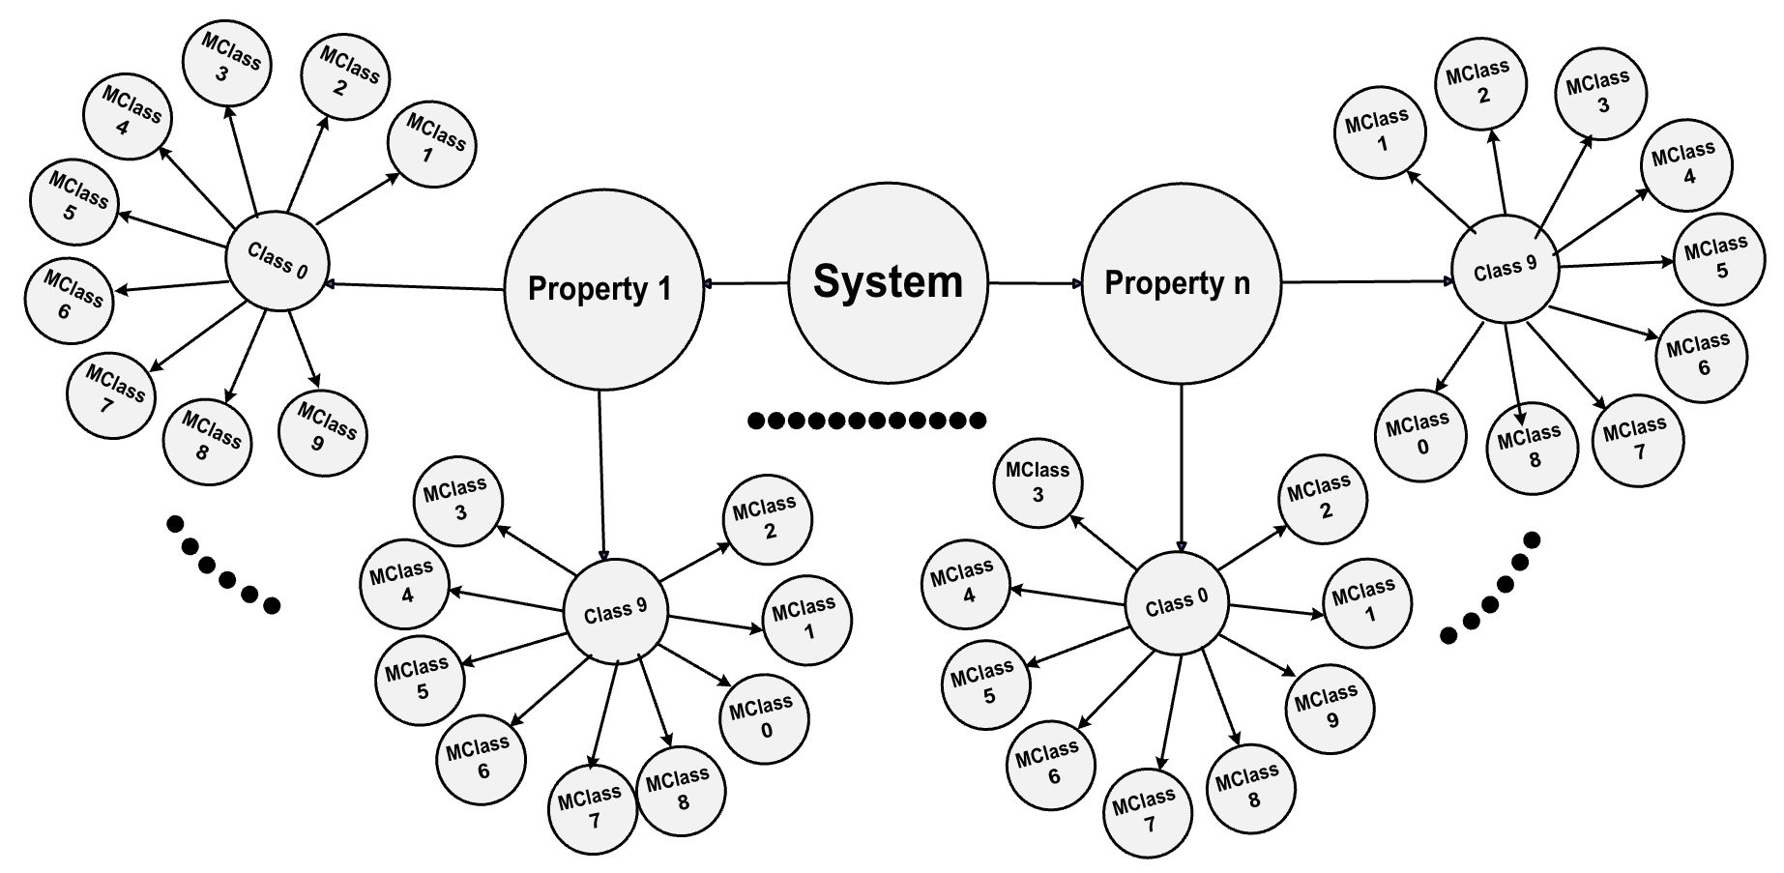
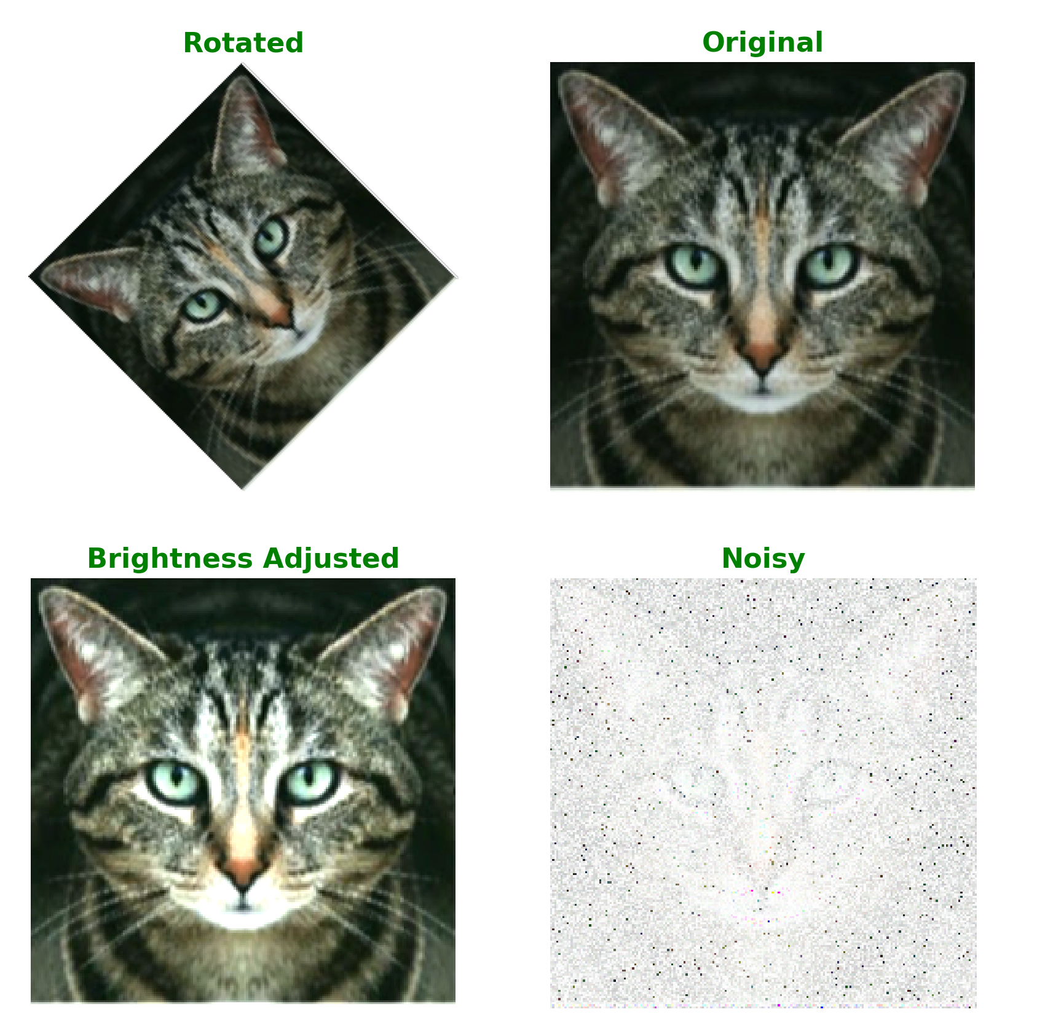
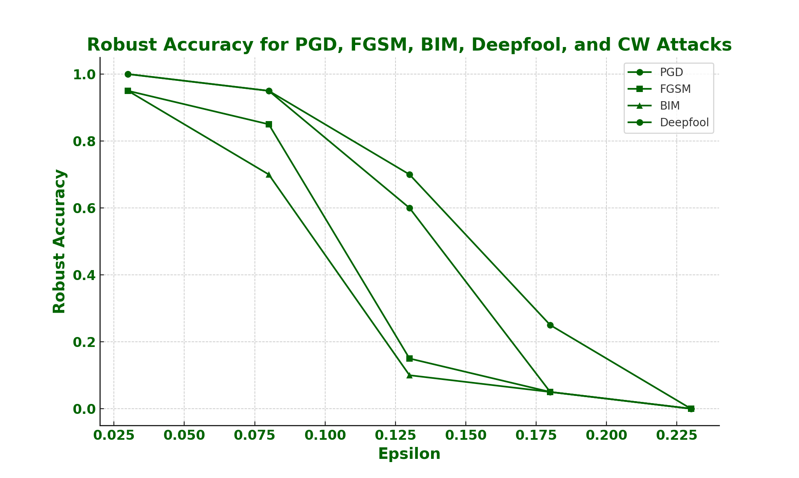
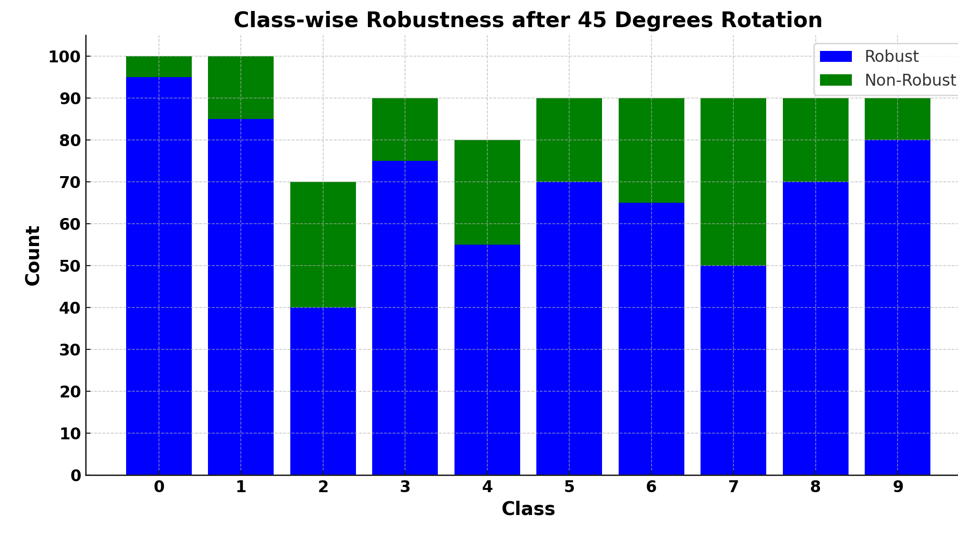
A Comprehensive Testing Framework for Deep Learning Models
Arooj Arif, Alexandros Koliousis, Elena Botoeva
Problem: non-robust deep learning (DL) applications
Idea: comprehensive testing framework for DL applications
Goal : evaluate local to global robustness
+
0.001
x
=
CAT
Perturbation
DOG
Challenge: no proper criteria for error summarization
to identify weakness
Result 1: generate test cases according to specification
Result 2: system robustness affected by different perturbations
Result 3: evaluate local robustness with rotation property
Notes:
Put R and T in flow

